Slide 1
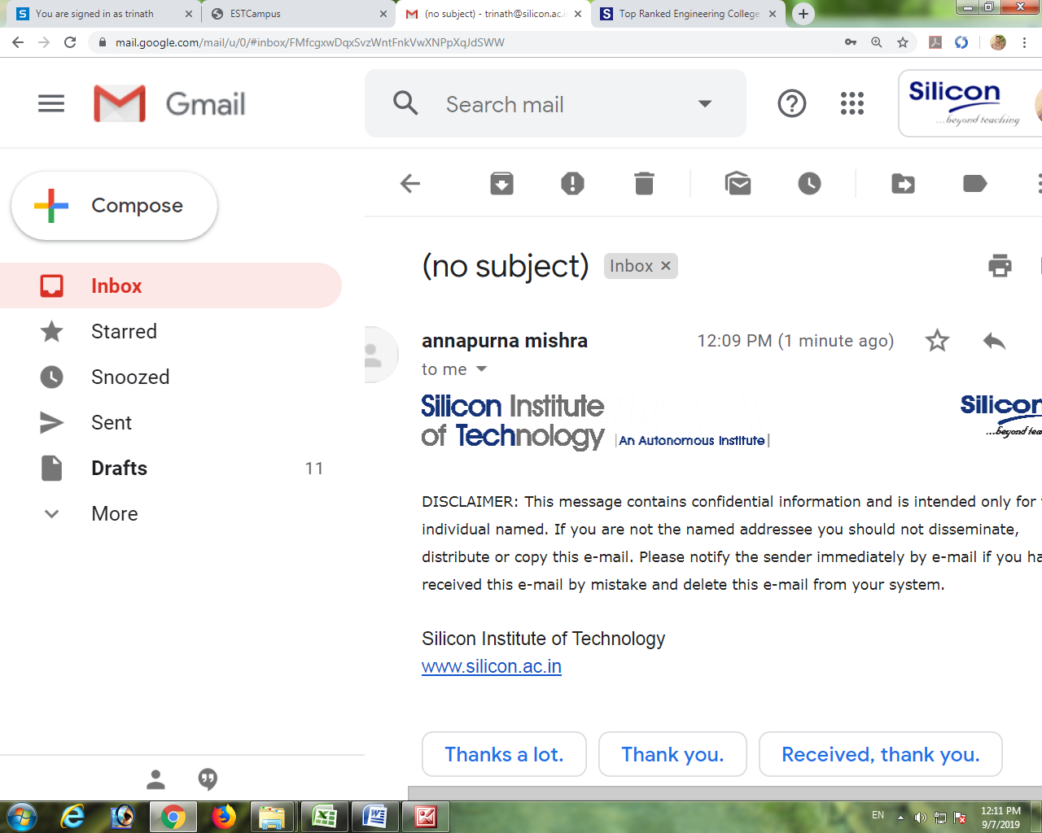
CLOUD BASED BLOOD BANK ASSISTANT
Department of
Computer Sc. & Engineering
Welcome to Final Project Presentation
CSE15
Submitted By
Sital Panigrahi (1901209442)
P Sai Mohan (1901209093)
Pranjal Agrawal (1901209398)
Under the Supervision of
Prof.(Dr) Kasturi Dhal
Senior assistant professor, Department of CSE

Slide 2
Introduction
A blood bank ensures that hospitals have a safe, reliable blood supply for patients in need.
Cloud computing is the on-demand availability of computing resources as services over the internet and uses Pay-as-you-go model.
BlooDrop helps hospitals to select the nearby blood banks, get potential donors, order required blood, deliver and track order and get assisted by chatbot.

Slide 3
Problem Statement
Traditional blood banking systems were developed by a 1 or 2 perspectives.
Unavailability of blood during emergency.
Less awareness among people about blood donation and blood transfusion.
System crash due to more request.
This project aims to make all the procedures automated and therefore with computer system it can be more fast and accurate.

Slide 4
Existing System
The operation of the blood bank still now is maintained in the manual system.
Onsite online application have no consistent availability.
Have no delivery tracking.
No bot assistance for specific questions related to blood transfusion.

Slide 5
Objective
To bridge the gap between blood banks, hospitals, volunteer donors and camp organizer, through this system.
Deployment of an easily available, secured, automated, assisted system.
To use GPS service to track delivery of required blood.
It consists of four main modules: Administration, Donor, Receiver(Hospitals) and activities.

Slide 6
Details
Browser
URL
Root URL
Templates
APP URL
VIEW
MODEL(ORM)
Database

Slide 7

Details
Load Balancer
Domain Name
SSL
Static IP
Load Balancer
Django
application
Auto
Scaling
Virtual Machine
Virtual Machine
Virtual Machine

Slide 8
Work Flow Diagram
Forming Database
Django
Backend
Connection
Design of
webpages
Django
application
Deploying in VM
SSL Configuration
Load
Balancing
Autoscaling

Slide 9
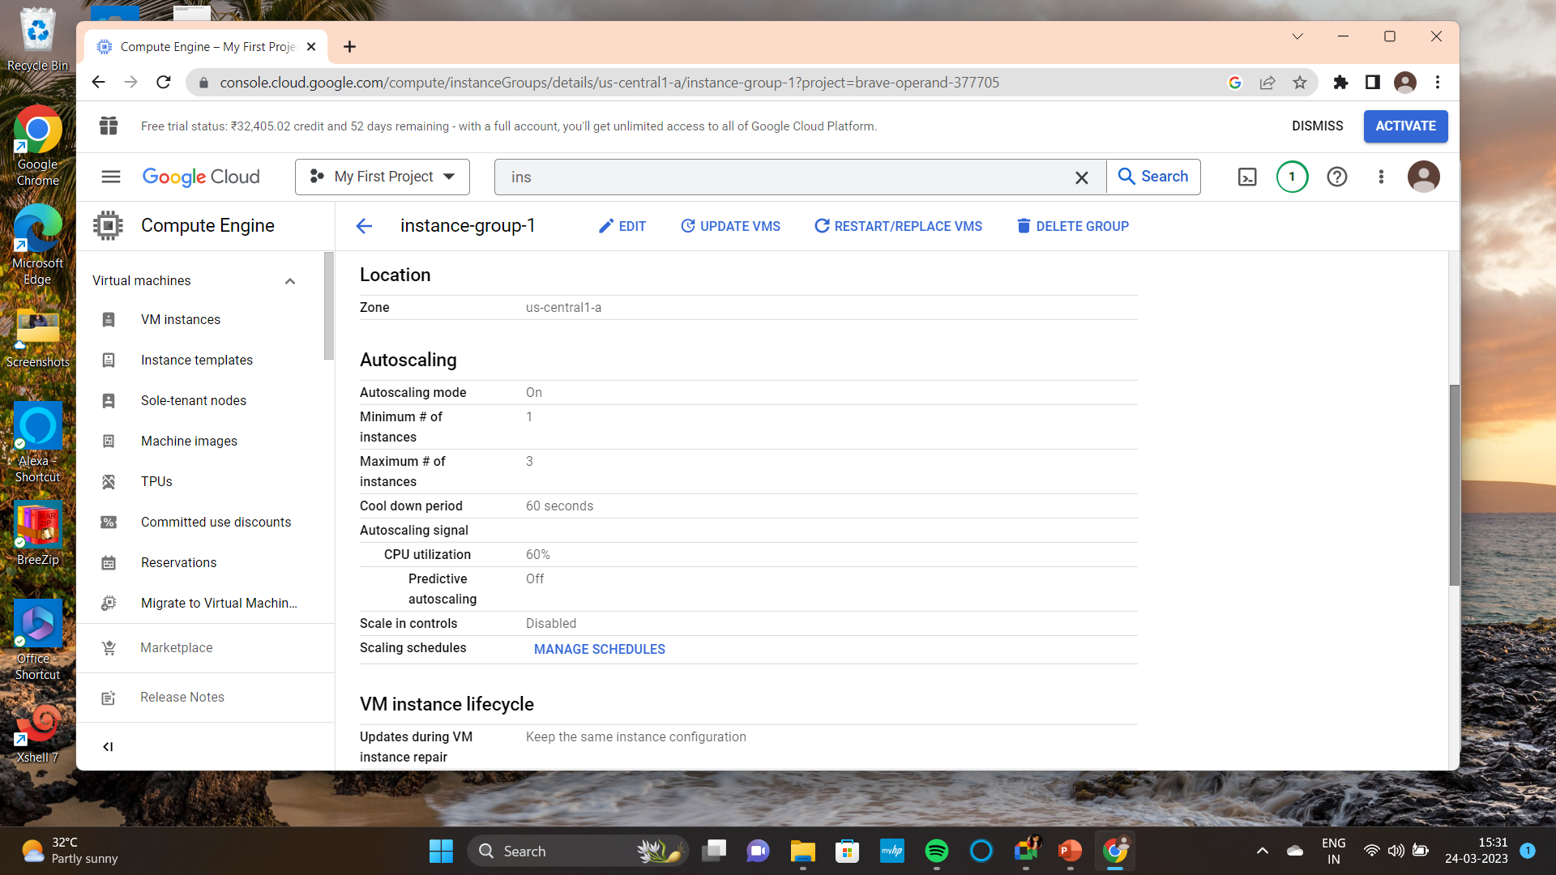
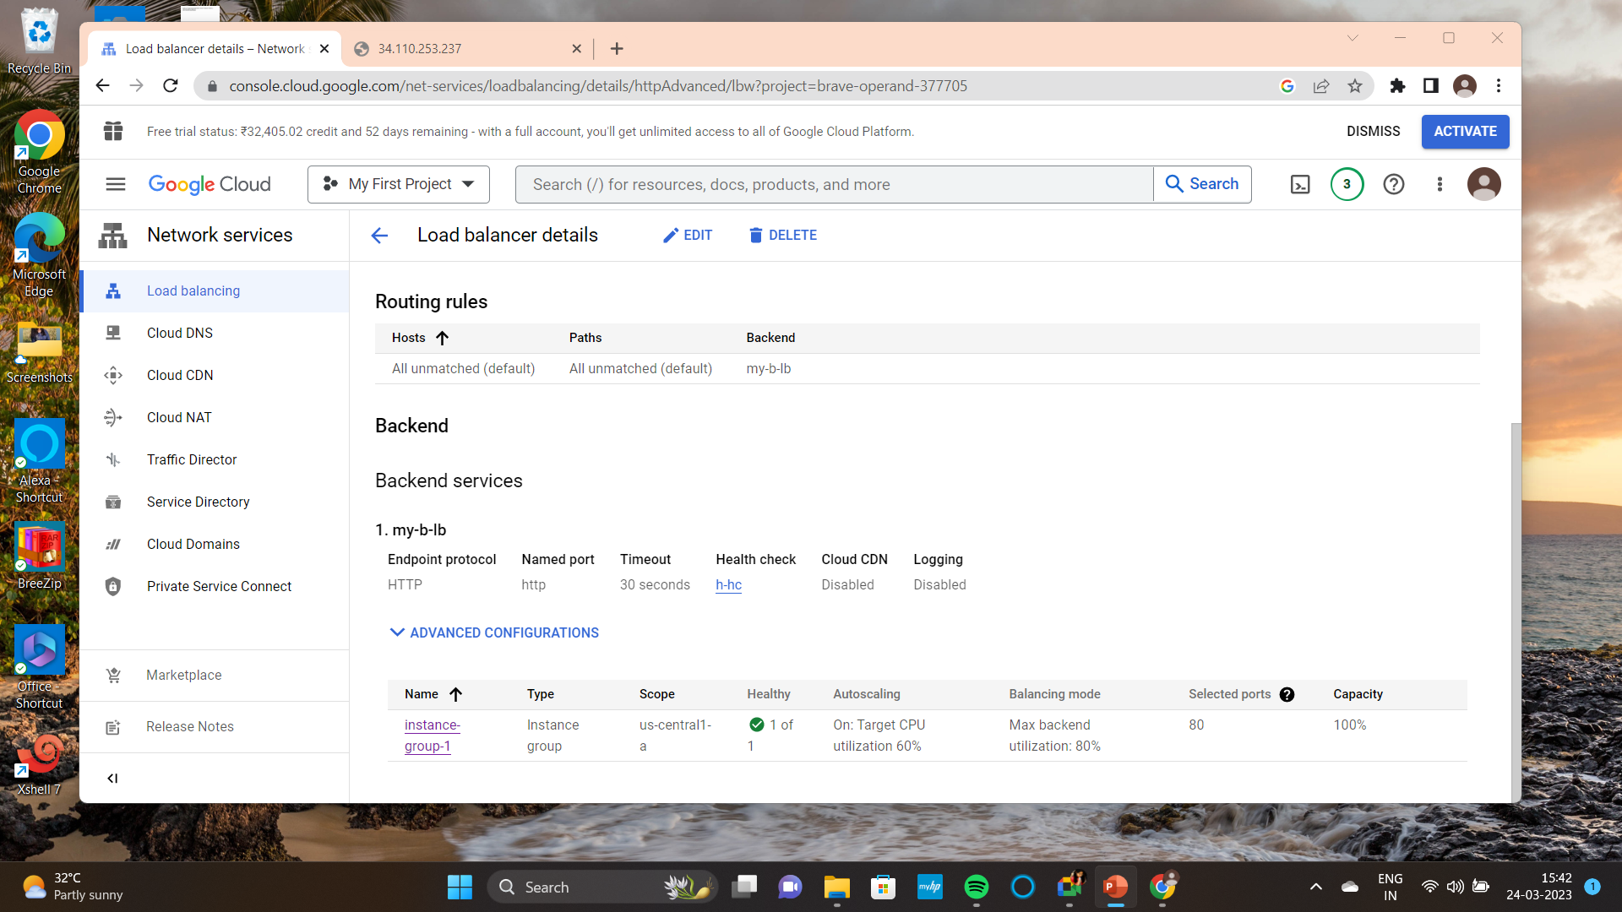
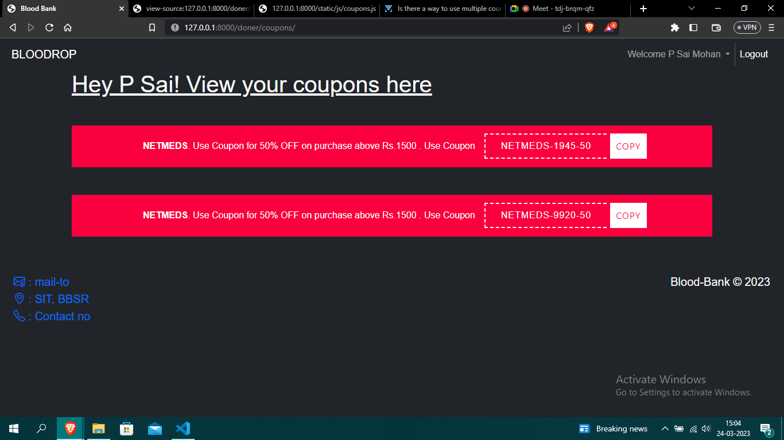
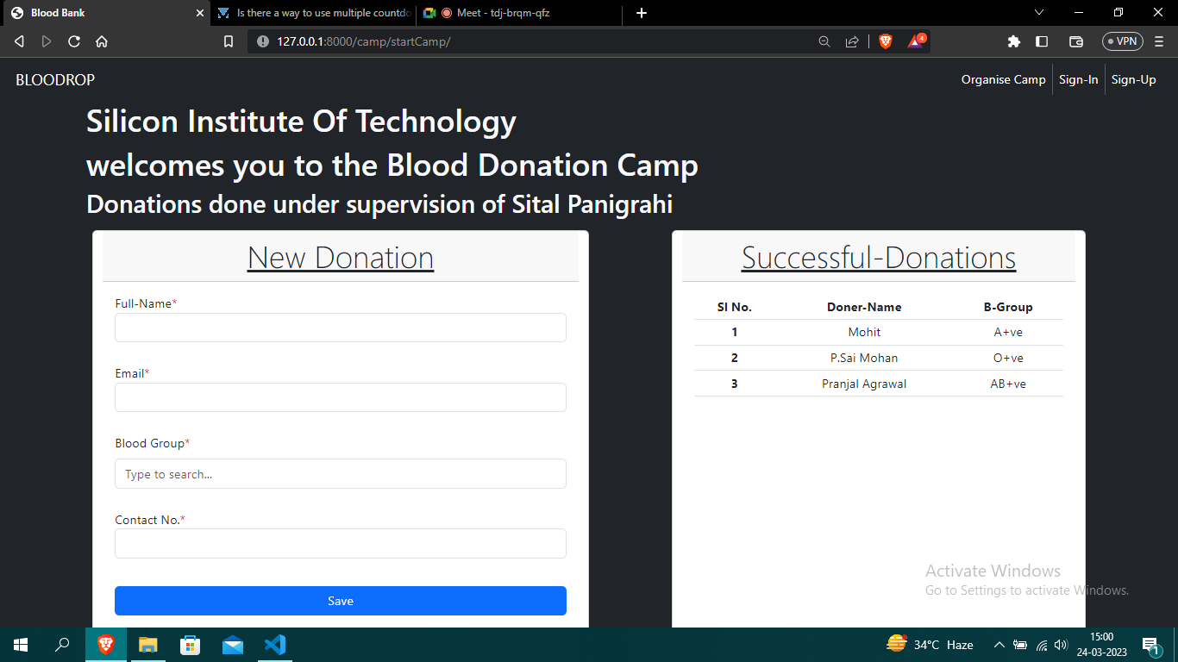
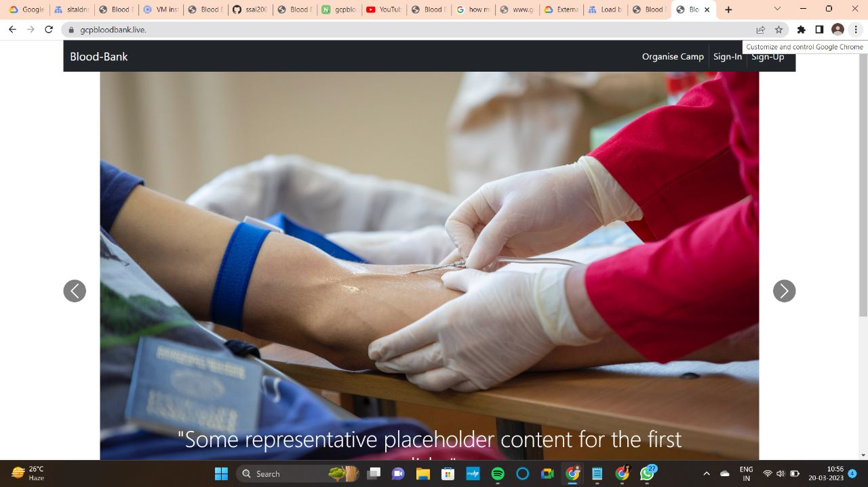
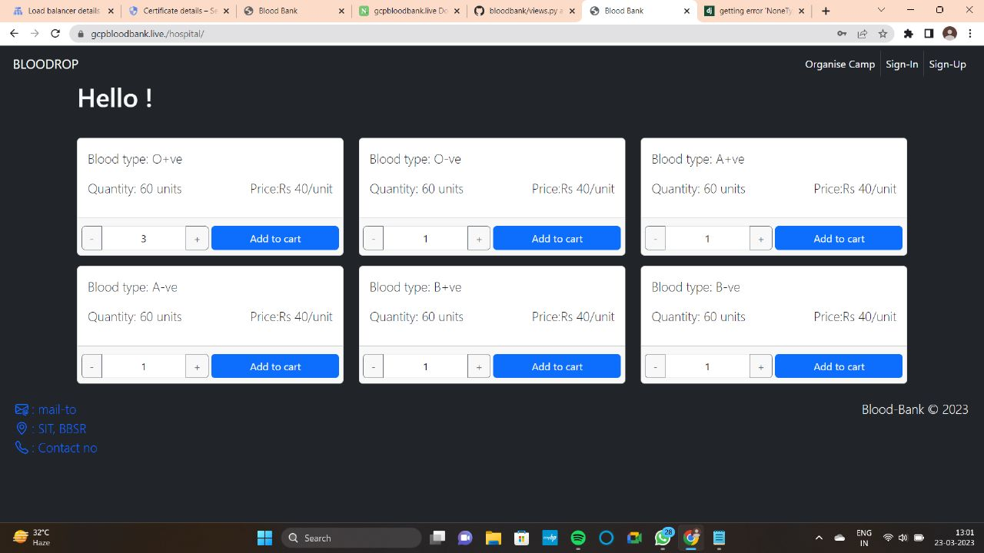
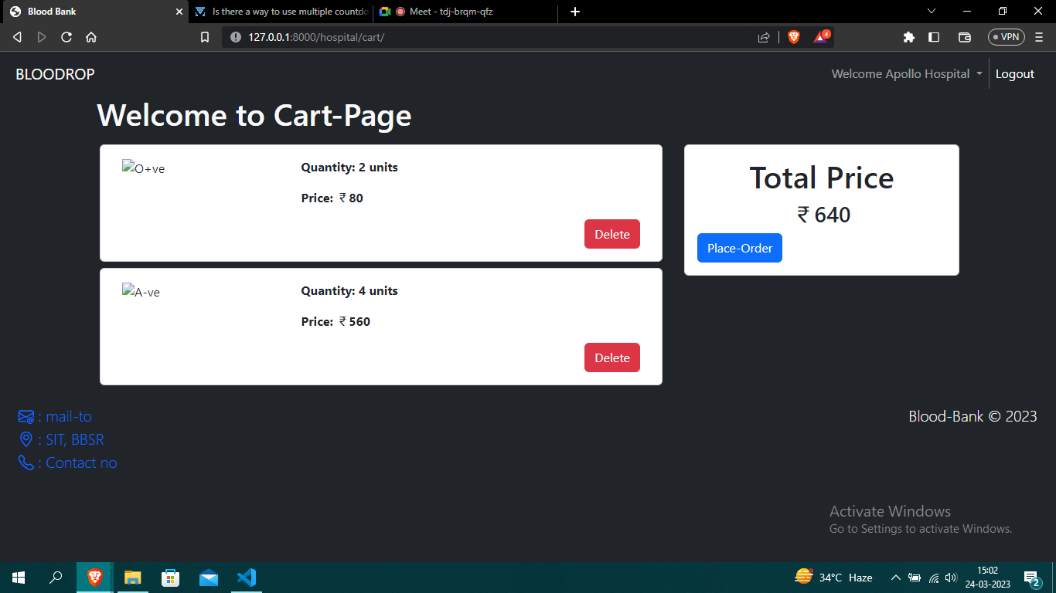
Snapshot

Slide 10

Contribution To The Society
This project aims to act as an important role in saving the life of the human beings and reduce the panic created in the emergency situation.
It makes blood easily available, so that searching process is easy.

Slide 11
Conclusion
Today the world is become a global village where everything is online.
It’s Important to make such facilities highly available.
This Project can further be extended for other medical services such as oxygen cylinder supply,etc.

Slide 12
Case timeline
Web page Design
Deployement and firewall configuration
Donor and hospital
Cloud
1st Week
2nd Week
3rd Week
4th Week
5th Week
Organize Camp
Backend
Cloud
Web Page Design
Using Django connecting Database & Frontend
Autoscaling and load balancing and SSL configuration

Slide 13
Resources
[1] A. Ali, I. Jahan, A. Islam and S. Parvez, "Blood donation management system", American Journal of Engineering Research, vol. 4, no. 6, pp. 123-136, 2015.
[2] A. Shah, D. Shah, D. Shah, D. Chordiya, N. Doshi and R. Dwivedi, "Blood Bank Management and Inventory Control Database Management System", Procedia Computer Science, vol. 198, pp. 404-409, 2022.
[3] T. Chandler, J. Hiller, S. Peine and T. Stargardt, "Blood donation and donors: insights from a large German teaching hospital (2008–2017)", Vox Sanguinis, vol. 115, no. 1, pp. 27-35, 2020.
[4] L. Sumaryanti, S. Suwarjono and L. Lamalewa, "E-Blood Bank Application For Organizing and Ordering The Blood Donation", International Conference on Science and Technology (ICST 2018), pp. 754-758, 2018.

Slide 14

THANK YOU

